Slide 1
A Brief History of Control
16-745
Spring 2021

Slide 2
In The Beginning…
Notes:
Brachistochrone Problem
What is the shape of a ramp that will result in the shortest time for a ball to roll from the starting point to a finish line at a lower height?
1696 – Posed by Bernoulli solved independently by Newton, Leibniz, and L’Hospital

Slide 3
The First Trajectory Optimization Problem
Notes:
Solution is a “cycloid”
Newton’s solution anticipated a lot of modern optimal control ideas that we use in trajectory optimization
In modern notation/language…

Slide 4
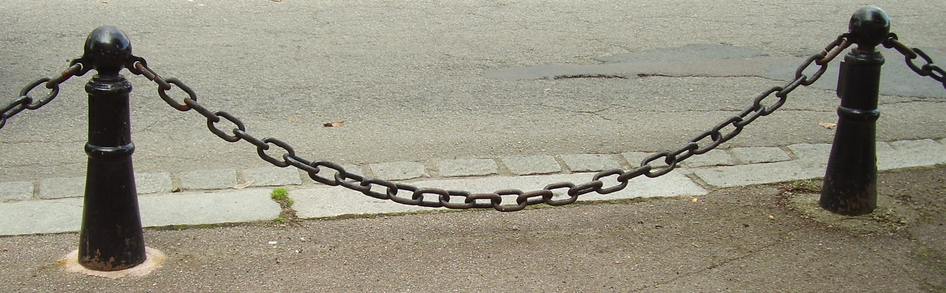
Calculus of Variations
Lots of Applications:
Statics (Catenary)
Optics (Fermat’s Principle)
Classical Mechanics (Hamilton’s Principle)
Finite-Element Methods (Weak formulation)
General Relativity (Einstein-Hilbert Action)
Quantum Mechanics (Feynman Path Integral)
Notes:
Newton’s strategy of optimizing one function w.r.t. another function/trajectory is now called “calculus of variations”
Functional calculus: take derivative of J function/”functional” w.r.t x(t) function/trajectory
Forms the core mathematical foundation of lots of physics + optimal control

Slide 5
Feedback Systems
Notes:
Centrifugal governor – opens/closes throttle to maintain desired RPM on a steam engine
Widely used beginning in late 1700s and was a huge part of the industrial revolution
James Clerk Maxwell (same as EM) published first rigorous theoretical analysis in 1868.
First use of many concepts from modern feedback control, including linearization and stability analysis for small errors.
Original paper is online – surprisingly readable.

Slide 6
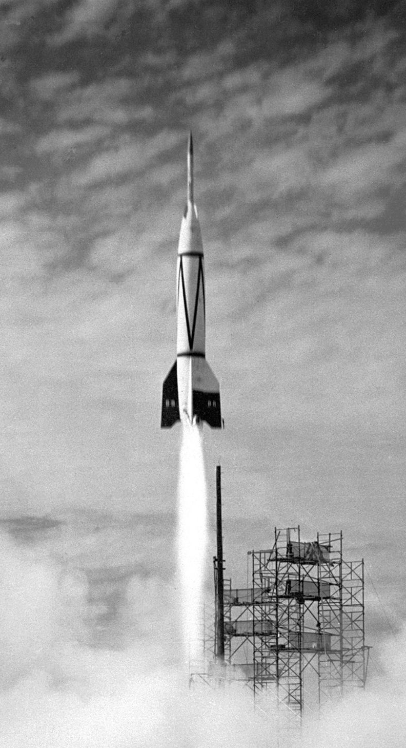
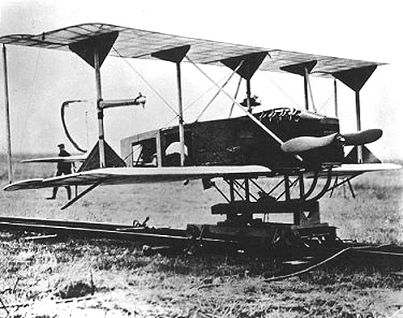
“Classical Control” (1910-1960)
Notes:
First automatic steering for ships 1911
First autopilot – Sperry 1914
Both used PID control. Formal theory not developed until 1920s
Negative-feedback developed to stabilize electronic (vacuum tube) amplifiers in late 1920s
Frequency-domain (Laplace transform) theory for SISO systems developed largely in EE community starting in late 1920s
Classic tools: Bode plots, phase and gain margins, root-locus method, Nyquist stability criterion
WW2 spurred rapid developments in autopilots for aircraft, guidance systems for torpedoes and missiles

Slide 7
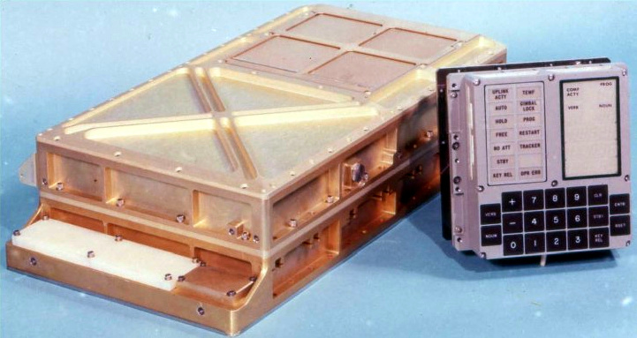
“Modern Control” (Post-1960)
Notes:
Rudolph Kalman initiated development of “state-space” techniques for control + estimation in 1950s-60s
Brought linear algebra/matrix math into the field. Was possible due to new computers.
Initially a lot of resistance – Kalman wasn’t able to publish his original filtering paper for several years
Breakthrough occurred thanks to Apollo program. Solutions were needed for tracking + guidance to get to the moon.
The extended KF for nonlinear systems and the square-root KF were both developed by Stanley Schmidt of NASA Ames for the Apollo guidance computer
In Parallel:
Lev Pontryagin developed the FON conditions for TrajOpt problems in the Soviet Union (max/min principle). First published in 1956.
Richard Bellman developed theory of dynamic programming and implemented on early computers. First published in 1953.
These 3 parallel developments led to the emergence of the field as we know it today.
Very closely connected to the development of computers.

Slide 8
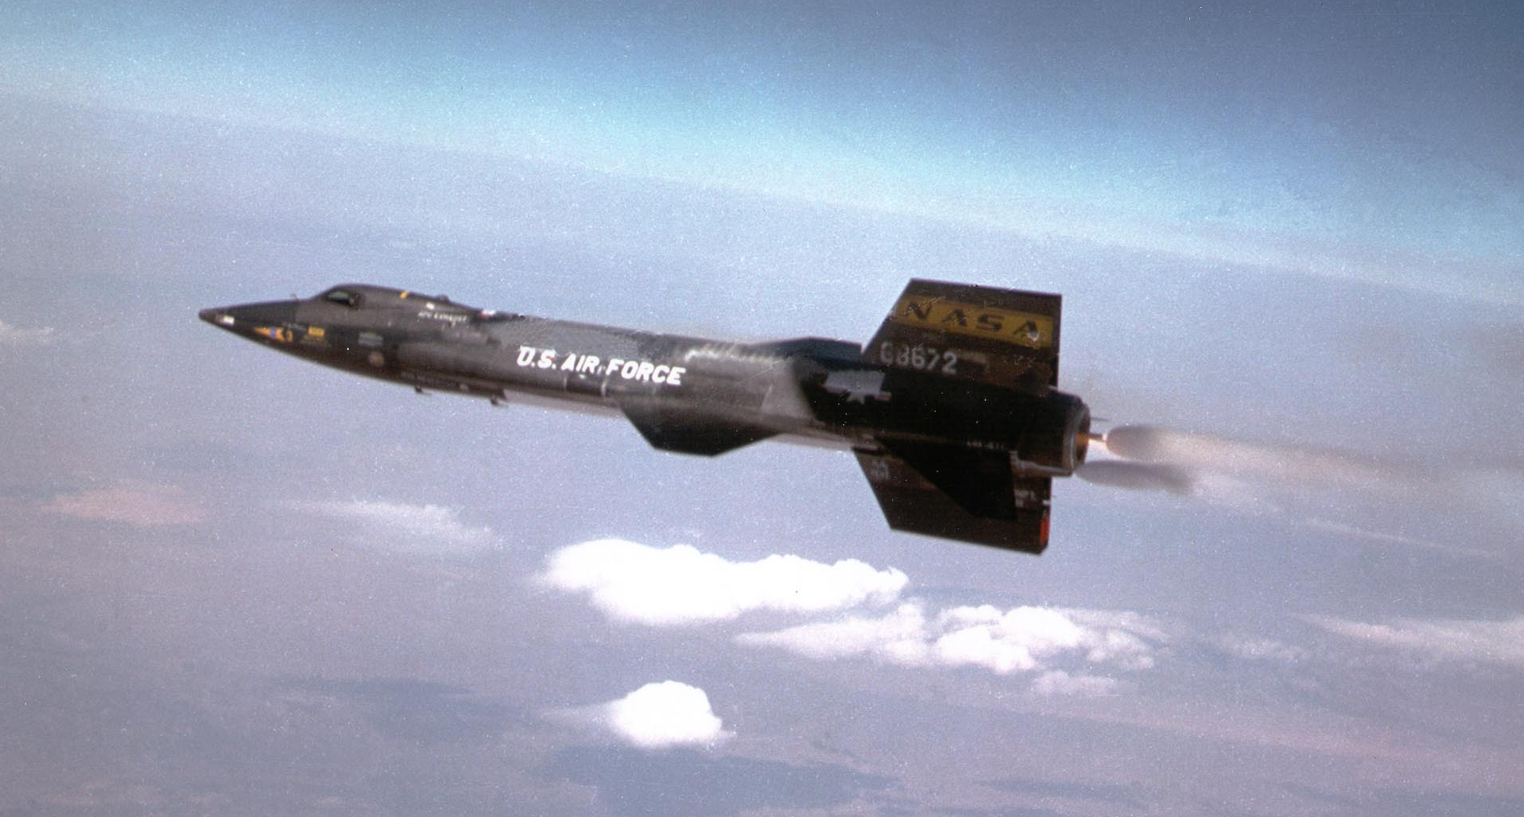
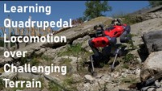
Adaptive Control and RL (1950s-Present)
Notes:
Try to deal with model uncertainty by learning model parameters (i.e. model-based) or tuning control parameters (i.e. model-free) online
Originally developed in 1950s for flight control systems on high-performance aircraft
Most early algorithms did some version of gradient descent on parameters to optimize a quadratic performance objective (e.g. “MIT Rule” from ~1960)
Stability + convergence was not well understood early on, led to a high-profile crash of the X-15 in 1967
Later a lot of work went into trying to guarantee stability of these methods.
Direct predecessor of current reinforcement learning algorithms.
Main difference is growth of computing power -> more parameters, more data
Older adaptive control methods generally learn a handful of controller or model parameters (linear models or parametric nonlinear models)
More recent algorithms can scale to deep NNs with millions of parameters
Modern RL learns possibly millions of weights in a neural network.

Slide 9
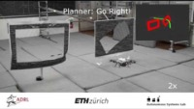
Model Predictive Control (1970s-Present)
Notes:
1970s-80s
Originally used in process control industry (e.g. chemical plants)
Linear system models
Needed to handle constraints
Dynamics were slow (e.g. control updates every ~10 seconds)
Could solve LPs and QPs on desktop computers of the era fast enough
Past ~10 years:
As computers have gotten faster, we can now solver larger + more nonlinear problems faster
Basically everywhere (cars, spacecraft, robots, etc.)
Video: state of the art ~5 years ago. Can run iLQR on full nonlinear model at ~100 Hz for real-time control of a quadrotor

Slide 10
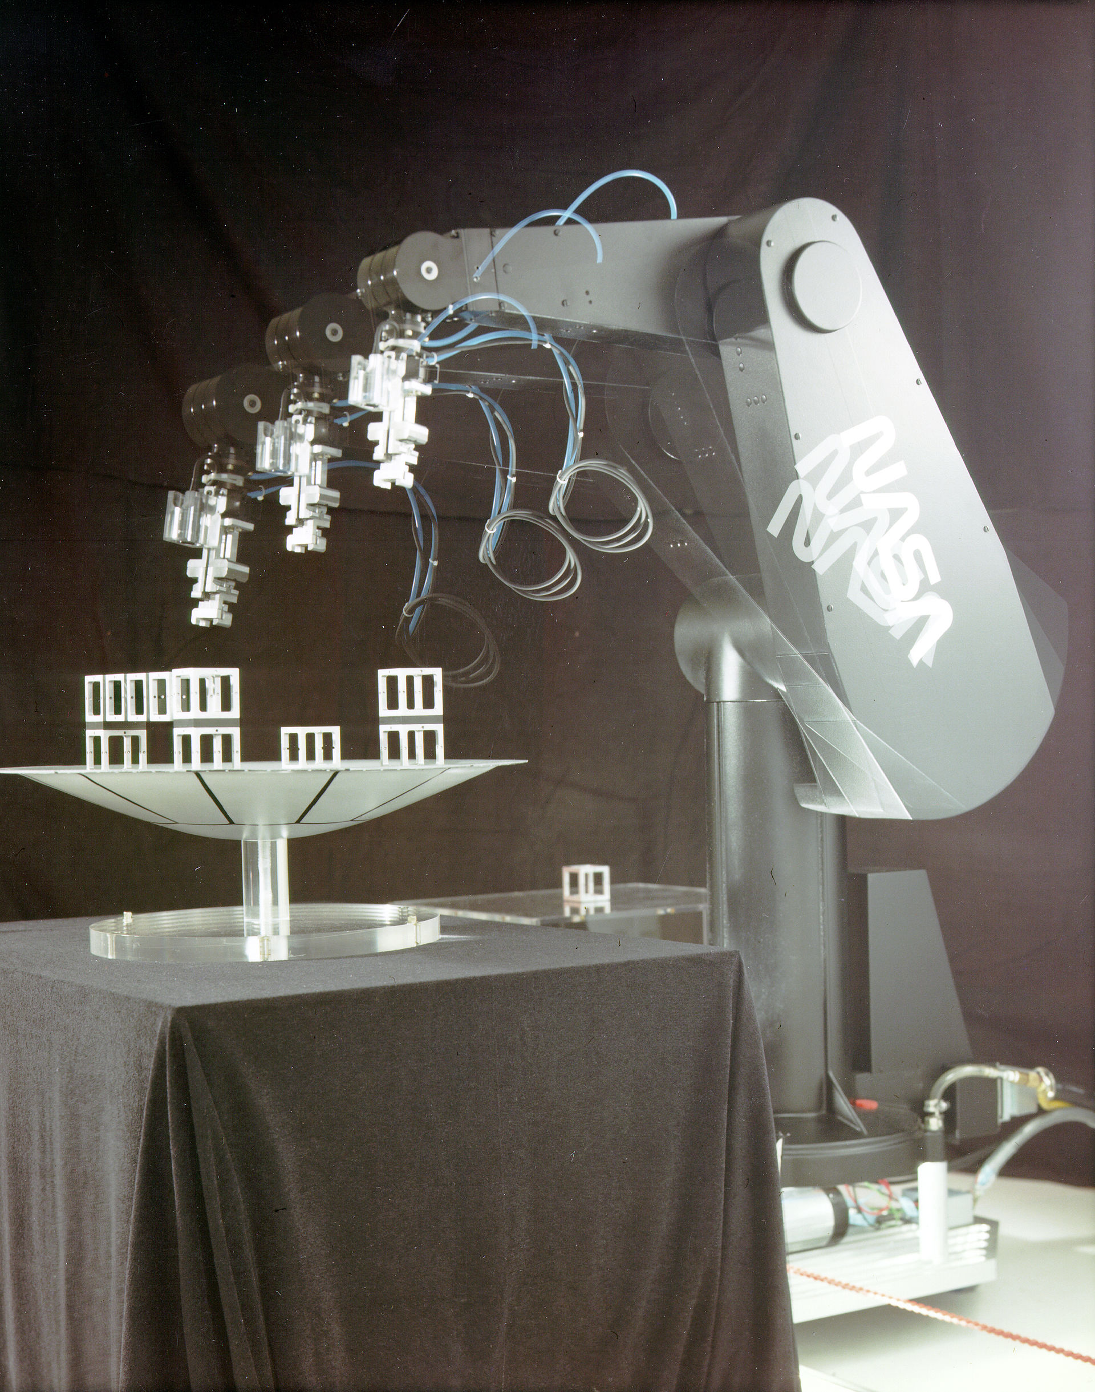
Robotic Manipulators: (1970s-80s)
Notes:
Kind of an aside…
Not much optimal control going on here historically
Mostly systems that are fully actuated and/or redundant
Enough actuators so that control problem is basically easy
We can just write down any end-effector trajectory we want and invert the manipulator dynamics in closed form to solve for the joint torques
Lots of closely related ideas here (Feedback linearization, operational-space control)

Slide 11
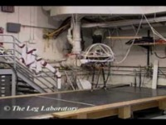
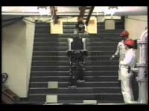
Legged Robots: (1980s-Present)
Notes:
Origins in 1980s:
Raibert: highly dynamic, used lots of heuristics, dynamics intuition, and simple PD control. Basically model free.
Honda: Used feedback linearization ideas from manipulation and hybrid switching at foot transitions. Not very dynamic due to need to maintain conditions required for feedback linearization (always one big flat foot in contact, maintain CoM at constant height). No optimization of reference trajectory. Not energy efficient.
Past 10~15 years:
Better computers -> modern optimal control -> highly dynamic quadrupeds + humanoids

Slide 12
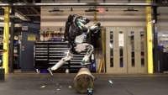
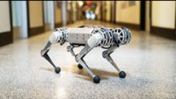
Legged Robots: (1980s-Present)
Notes:
Past 10~15 years:
Better computers -> modern optimal control -> highly dynamic quadrupeds + humanoids
Various flavors of offline trajopt + online MPC
Use of sophisticated models to exploit full hardware capabilities

Slide 13
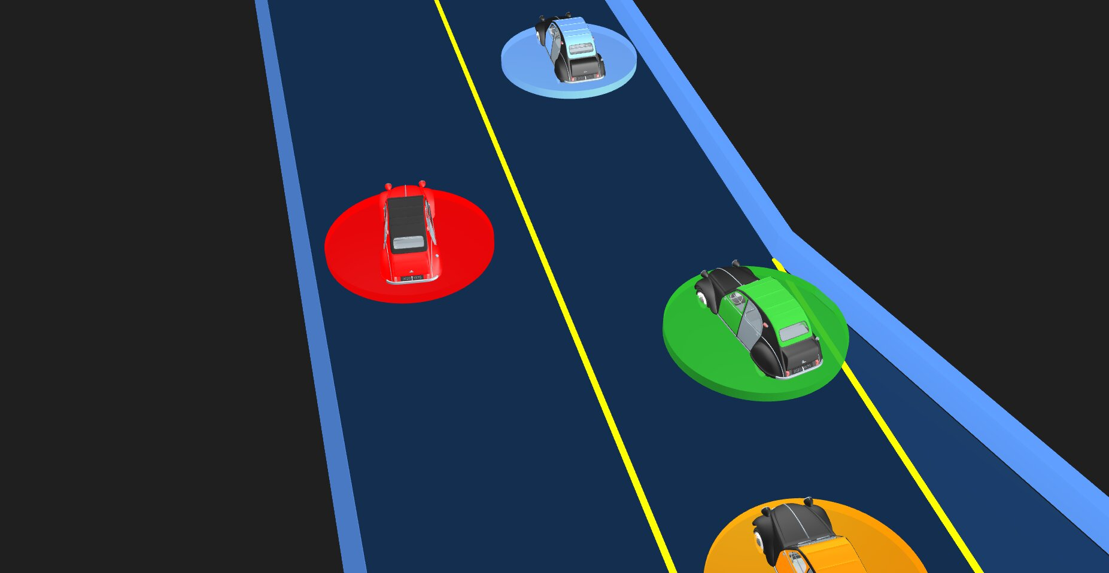
Challenges for the Future?
General theory for dealing with contact
Bridging the gap between model-based control and RL
Making RL more data efficient by incorporating prior knowledge
Safety guarantees for uncertain nonlinear systems
Dealing with other (possibly adversarial) agents

Slide 14
Questions?
Comments?

